Slide 1
High Speed Networks Introduction
Robert Iakobashvili,
Author: Akiva Sadovski from Broadcom
Spring 2022

Slide 2
Introduction to Wide Area Networks
Agenda
WAN?
Why to focus on WAN?
Evolution
Benefits/business drivers
Challenges and risks

Slide 3
Wide Area Networks
LAN:
Owned and managed by single organization
Primary purpose: provide network access to hosts
WAN:
Typically pay-for-service
Provided and managed by regional telecommunications carriers
Designed to interconnect networks

Slide 4
Why to study WAN now?
Challenging
Next big thing
Happens right now

Slide 5
Challenges
Complex topologies
Wild mix of technologies
Commodity

Slide 6




Complex topologies
Medium Businesses
SOHO
Residential
Large
Enterprises
Residential
SN
SN
WAN
SN
Service
Interfaces
House Wiring
LANs
OADM
Router
Broadcast
Services
OXC
Router
STM-4/16 speed level
OADM
Router
CM
Regional / Metro
(Data Back Bone)
CGW
CGW
Digital
&
Analog
OANT
Coax Cell
STM-16/64 speed level
DWDM
OADM
Router
CGW
Digital
&
Analog
OANT
Data Modems (CMTs) moving to the OANTs
Frequency Reuse in the Coax Distribution Cells
Digital
&
Analog
HFC
Head-end
CGW
Coax Cell
CATV
Back Bone
Optical
Access Network
CGW
CATV Cable Television
CGW Coax Gate Way
CM Cable Modem
CMT Cable Modem Termination
HFC Hybrid Fiber Coax
OADM Optical Add Drop Multiplexer
OANT Optical Access Network Termination
OXC Optical Cross Connect
SN Service Node
SOHO Small Offices, Home Offices
WAN Wide Area Network (all fiber)
Coax Cell
Coax
5 to 1000MHz
Downstream:
FDM (AM VSB, QAM)
Upstream:
FDMA/TDMA (QAM)
Digital
&
Analog
OANT
CGW
CGW
Telscom Consulting, Switzerland

Slide 7


Slide 8


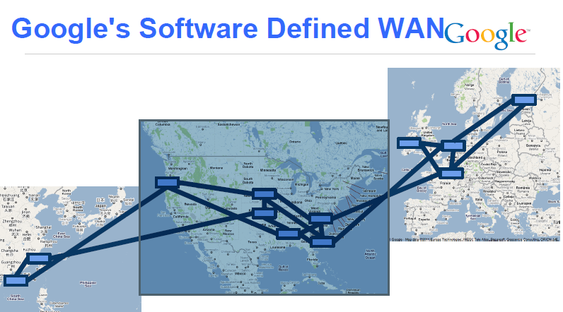
Next big thing

Slide 9
Happens right now
Significant transformation is taking place in data communications (MEF 2014):
Deliver self-service, on-demand services over interconnected networks
Enable the user to dynamically and on-demand, create, modify and delete services via customer web portals or software applications

Slide 10
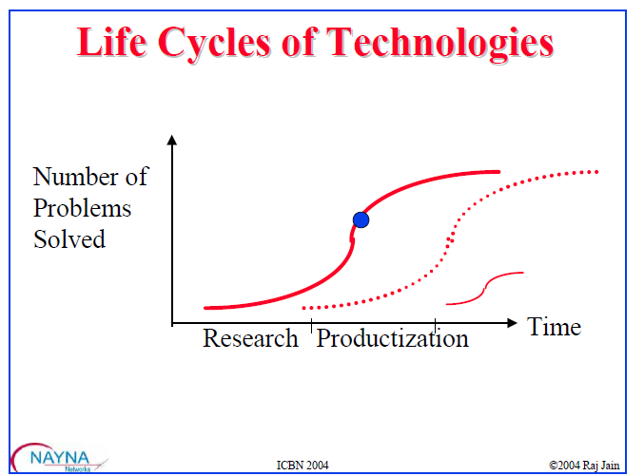
Life Cycle

Slide 11
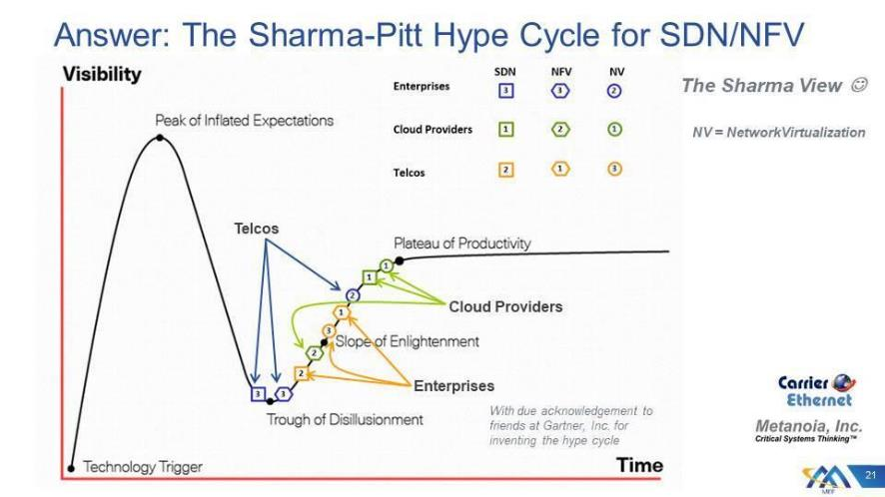
Hype

Slide 12
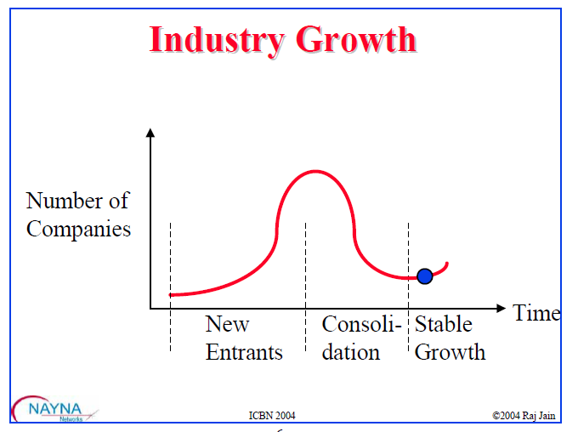
Growth

Slide 13
Evolution : ARPANET
1968: ARPANET was founded by the Advanced Research Projects Agency (ARPA) to serve as test bed for packet switching technology
197x:
ARPANET evolved to consist of roughly 210 PSNs
minicomputers interconnected point-to-point
1995 - NSF awarded MCI a contract to build a 155 Mb per second (Mbps) speed backbone

Slide 14
Evolution : SONET/SDH
SONET=Synchronous optical network
SDH=Synchronous digital hierarchy
Standard for digital optical transmission
198x: Developed originally by Bellcore to allow mid-span meet between carriers: MCI and AT&T
You can lease a SDH connection from carriers

Slide 15
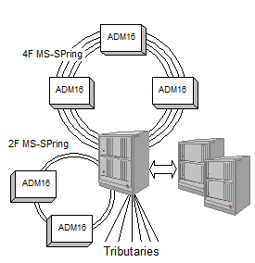
SONET/SDH Highlights
Ideal for Voice: No queues. Guaranteed delay
Protection: Allows redundant Line or paths
Fast Restoration: 50ms using rings
Fixed Payload Rates: 51M, 155M, 622M, 2.4G, 9.5G
Rates do not match data rates of 10M, 100M, 1G, 10G
Static rates not suitable for bursty traffic
High Cost
Complex service set up

Slide 16
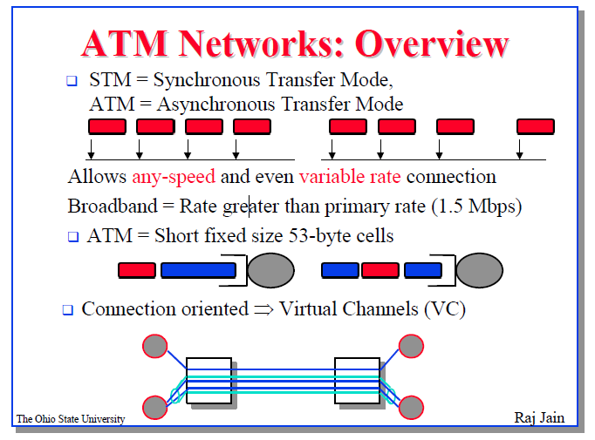
Evolution: ATM
1980x: Research on Fast Packets
October 1991: ATM Forum founded

Slide 17
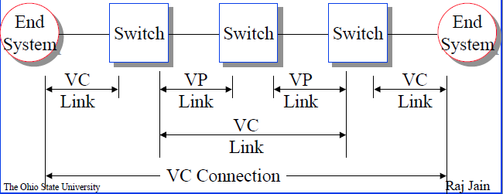
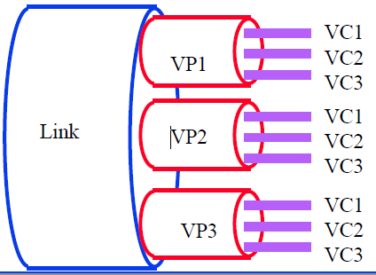
ATM Highlights
Protocol layers
Connection identifiers
Each cell contains a 24/28-bit connection identifier
First 8/12 bits: Virtual Path, Last 16 bits: Virtual Channel
Connections via Channels
LAN Emulation
Problem: need new networking SW for ATM
Solution: let ATM network appear as LAN
LAN emulation implemented below OS network layer

Slide 18
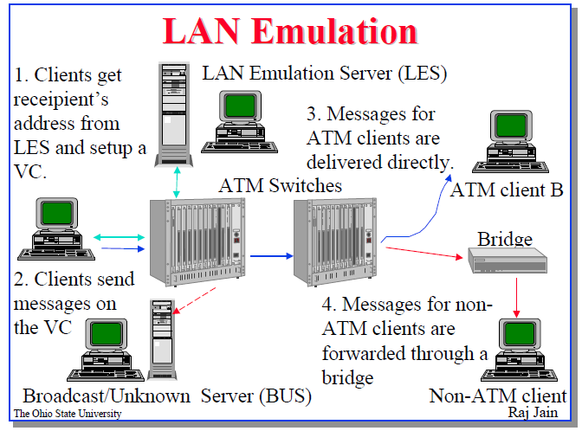
ATM Challenge
High Cost
Complex service set up

Slide 19
Ethernet: 10GbE
200x: main standardization effort
Compatible with 802.3 frame format, services, management
LAN and WAN distances
Full-duplex only ⇒ No Shared Mode. Only switch based networks. No Hubs
Same min and max frame size as 10/100/1000 Mbps

Slide 20
Ethernet in WAN - Greenfield

Slide 21
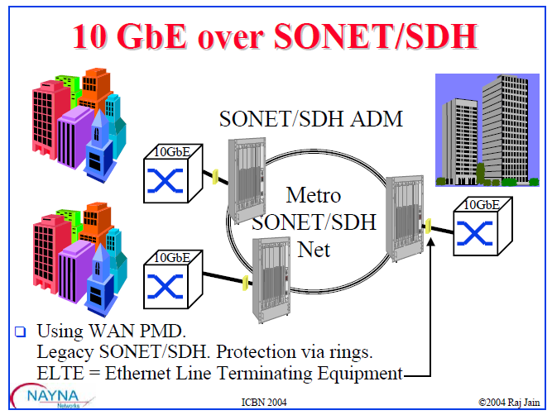
Ethernet in WAN - Legacy

Slide 22
MPLS Timeline
Notes:
IP addresses are allocated hierarchically: IP addresses that share the same prefix often share the same next hop. This reduces the routing table size and enhances scalability
When looking up a DIP in the routing table, several entries with different prefixes may match it.
The entry chosen is the one with the Longest Prefix Match (LPM)
HW LPM implementation was problematic in the 90-s
Therefore Cisco suggested to add a fixed length identifier to IP packets to speed up routing decisions

Slide 23
Where it is used?
MPLS packets can run on Layer 2 technologies such as ATM, FR, PPP, PoS, Ethernet
Other Layer 2 technologies can be run over an MPLS network: Ethernet-over-MPLS, FrameRelay-over-MPLS etc
Currently, MPLS is a technology for delivery of IP Services:
Virtual Circuit for IP: Unidirectional path (tunnel) through the network
Traffic Engineering: Using paths other than the IGP shortest-path

Slide 24
Label Switching Path
Notes:
LER A:
Class Rule 1: PUSH 150
Class Rule 2: PUSH 100
LSR B:
ILM:
Ingress=eth1, InLabel=150, SWAP, OutLabel=250, Egress=eth2
Ingress=eth1, InLabel=100, SWAP, OutLabel=110, Egress=eth2
LSR C:
ILM:
Ingress=eth1, InLabel=250, SWAP, OutLabel=350, Egress=eth2
Ingress=eth1, InLabel=110, SWAP, OutLabel=120, Egress=eth3
LER D
ILM:
Ingress=eth1, InLabel=350, POP, OutLabel=N/A, Egress=eth2
LER D
ILM:
Ingress=eth1, InLabel=120, POP, OutLabel=N/A, Egress=eth2

Slide 25
Next Step
2004 - Software Defined Networks
201x – Network Functions Virtualization
201x –SD-WAN

Slide 26
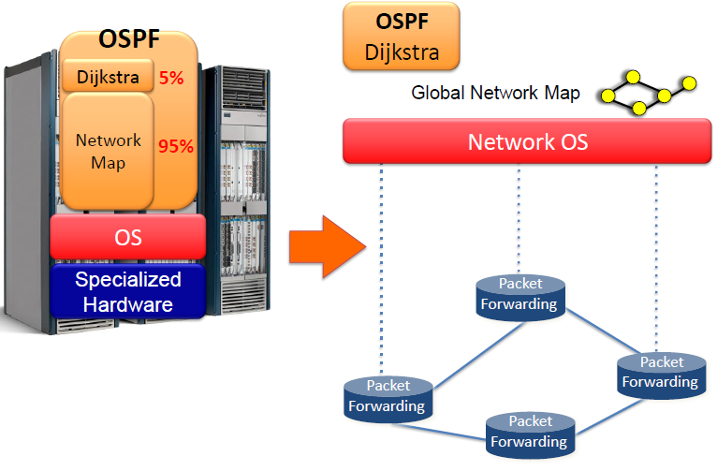
SDN in a nutshell
Source: Nick McKeown Stanford University

Slide 27
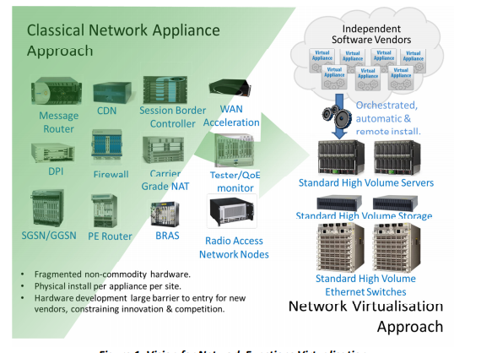
Vision for NFV
Source: ETSI

Slide 28
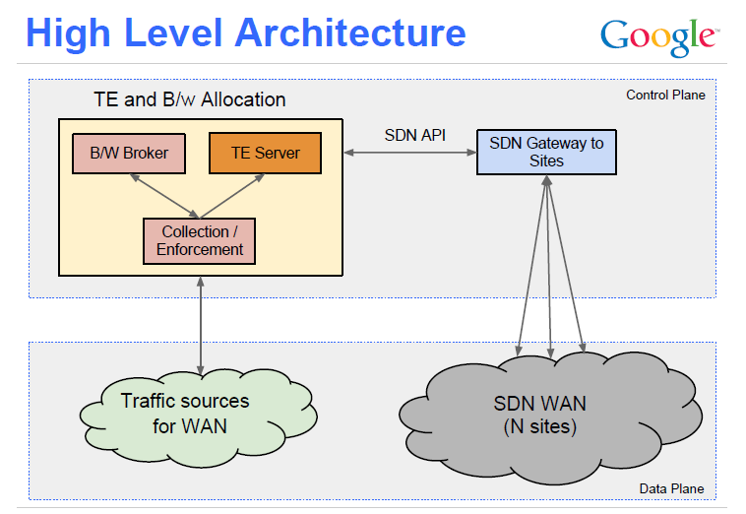
Bringing SDN to WAN

Slide 29
Business drivers
On-demand Services
activation times which can no longer take days or weeks
Expectation for Quality
users expect the performance of their apps in the remote cloud to behave as they do when running locally on their LAN
Value Perception
network becomes practically invisible until it negatively impacts the application experience
Network Abstraction Reduces Headaches
applications running on the standard hardware

Slide 30
Risks and challenges
Managing the WAN
Security policies
Performance

Slide 31
Network Node – Packet Classification
Exact Match
Prefix Matching
Content Addressable Memory
Multi Field Prefix Matching

Slide 32
Network Node – Queue Management
Tail Drop
Random Early Discard (RED)
Fair Random RED
QCN – Quantized Congestion Notification
CHOKE algorithm

Slide 33
Network Node – Packet Scheduling
FIFO queueing
Strict priority
Round Robin
Deficient Round Robin
Generalized Processor Sharing (GPS) and Weighted Fair Queue
Hierarchical scheduling

Slide 34
Traffic Metering and Marking
Single Rate Three Color Marker
Two Rate Three Color Marker
Etc

Slide 35
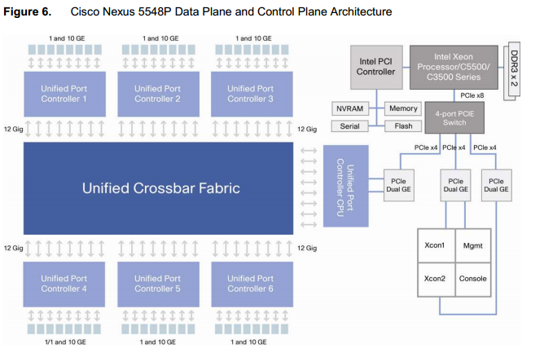
Network Node – Switch Fabric
General Switch Architecture; Blocking
Switching Fabric
Time division switching
Space division switching
Virtual Output Queuing
Take a Ticket
Parallel Iterative Matching
iSLIP

Slide 36
Network Node – Multistage Switch Fabric
Clos Network
Clos Network Heuristics: Concurrent Round-Robin-Dispatching (CRRD)
Banyan Network
Congestion in Delta Networks
Benes Network

Slide 37
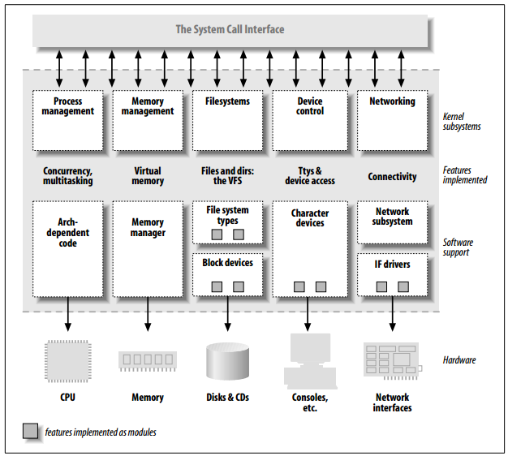
Real World Examples from Linux Kernel
5332883.html

Slide 38
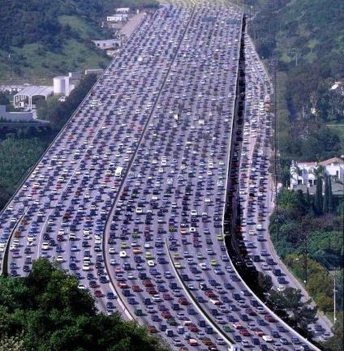
Quality of Service
Integrated Services
Reservation Protocol (RSVP)
Differentiated Services (DiffServ)
Per Hop Behavior (PHB)
Expedited Forwarding
Assured Forwarding

Slide 39
MPLS
Intro to Multi Protocol Label Switching
Label Switching Path (LSP)
MPLS Label and Label Stacking
Inside MPLS Router
LSP Tunnels
MPLS Data Plane and Control Plane
Label Distribution Protocol

Slide 40
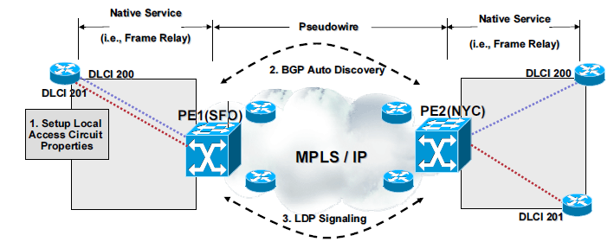
Advanced MPLS and MPLS applications
Introduction to Traffic Engineering (TE)
MPLS Fast Re-Route (FRR)
Pseudowire (PW)
Virtual Private Networks
MPLS Transport Profile (MPLS-TP)

Slide 41
Virtual Private Networks
Pseudowires and pseudowire encapsulations over MPLS
L2 Virtual Private Networks
Virtual Private Wire Service
Virtual Private LAN Service
MPLS L3 VPN

Slide 42
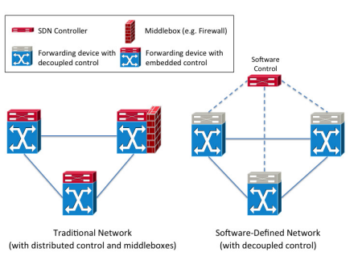
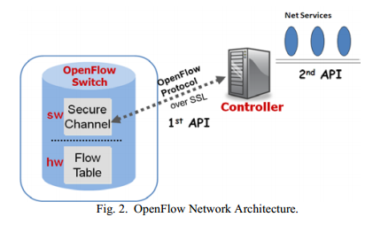
Software Defined Networks (SDN)
Rationale behind SDN
Software-Defined Networking Architecture
Data Plane – Control Plane separation
OpenFlow

Slide 43
Final Assessment
50% - Final coursework
50% - Exam

Slide 44
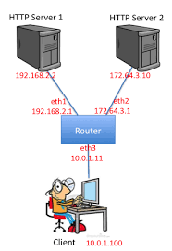
Homework 1
Simulator
Mininet: http://mininet.org/ written in Python, extendable by writing add-ons in Python
Build simple topology:
Experiment with it

Slide 45
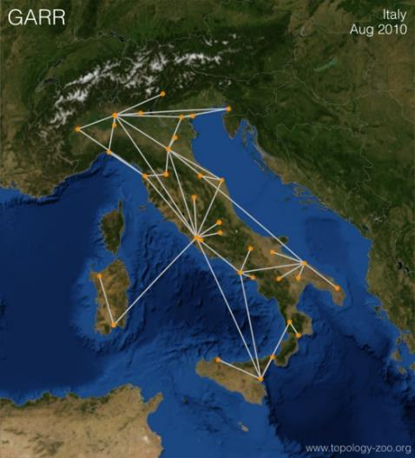
Homework 2
Mininet
Real world Network Simulation
Throughput and packet delay measurements

Slide 46
Materials to be submitted
Model-related software. Generally it will be a single Python script implementing the Mininet model; provide any other SW if required
One page report with short description and results

Slide 47
Coursework
?

Slide 48

Network taxonomy

Slide 49
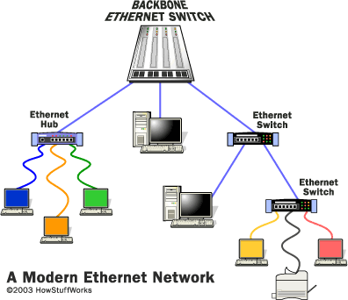
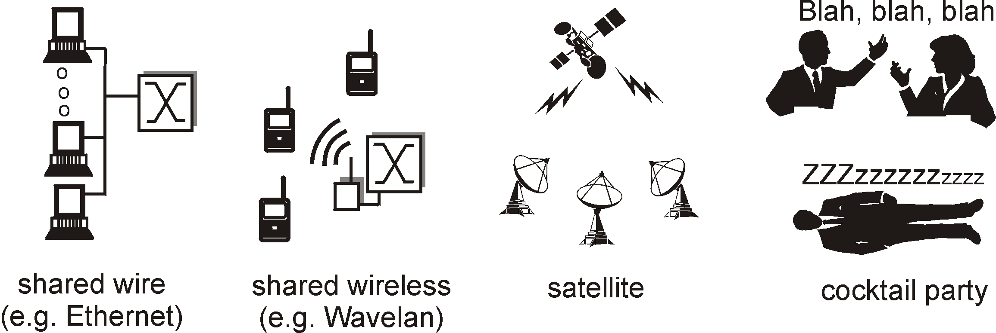
Multiple Access Links and Protocols
Three types of “links”:
point-to-point (single wire, e.g. PPP, SLIP)
broadcast (shared wire or medium; e.g Ethernet)
switched (e.g., switched Ethernet, ATM etc)

Slide 50
Nodes
Nodes may connect:
To other nodes only, or
To stations and other nodes
Network is usually partially connected
Some redundant connections are desirable for reliability
Two different switching technologies
Circuit switching
Packet switching

Slide 51
Switching Networks
Long distance transmission is typically done over a network of switched nodes
Nodes not concerned with content of data
End devices are stations
Computer, terminal, phone, etc
A collection of nodes and connections is a communications network
Data is routed by being switched from node to node

Slide 52
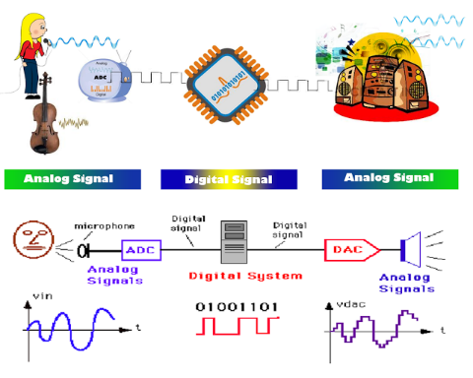
Information
The world doesn't run on bits, bytes, circuits, or even packets
Source http://itsallaboutembedded.blogspot.co.il/

Slide 53
Circuit switching - 1
Circuit switching was the first switching technique used in communication networks because it is simple enough to carry analog signals
Circuit switching was designed in 1878 in order to send telephone calls down a dedicated channel
In circuit switching, the transmission medium is typically divided into channels using Frequency Division Multiplexing (FDM), Time Division Multiplexing (TDM) or Code Division Multiplexing (CDM)
This channel remains open and in use throughout the whole call and cannot be used by any other data or phone calls

Slide 54
Circuit Switching - 2
Dedicated communication path between two stations
Three phases:
Establish
Transfer
Disconnect
Must have switching capacity and channel capacity to establish connection
Must have intelligence to work out routing
Once connected, transfer is transparent

Slide 55
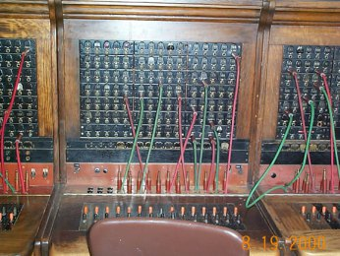
Circuit switching – circuit establishment
To establish the circuits, a signaling mechanism is used
Signaling is the process of exchanging messages within the control plane to
set up
maintain
modify
terminate
data paths in the data plane
It is the most complex part in circuit switching

Slide 56
Circuit switching – bandwidth reservation
In circuit switching the channel bandwidth is reserved for an information flow
To ensure timely delivery of the data, the capacity of the circuit has to be at least equal to the peak transmission rate of the flow

Slide 57
Circuit switching – call blocking
If there are not enough channels for the request, the call establishment may be :
delayed
blocked
dropped
In contrast, once the call is accepted, resources are not shared with other flows, eliminating any uncertainty

Slide 58
Circuit switching drawbacks
Circuit switching designed for voice
Resources dedicated to a particular call
Much of the time a data connection is idle
Data rate is fixed
Both ends must operate at the same rate

Slide 59
Packet Switching: Basic Operation
Data transmitted in small packets
Typically 1000 octets
Longer messages split into series of packets
Each packet contains a portion of user data plus some control info
Control info
Routing (addressing) info
Packets are received, stored briefly (buffered) and past on to the next node
Store and forward

Slide 60
Packets
Packet networking is the translocation of data between distributed computational processes
The packets are arbitrary divisions of data flows, and should not be treated like physical objects
The packets are repeatedly duplicated and erased

Slide 61
Packets, frames, etc
Packet – small portion of data and corresponding headers, usually L3 and higher
Frame – L1 and L2
Buffer – area in the node’s memory allocated for a frame or a packet storage

Slide 62
Use of Packets

Slide 63
Packets Switching Advantages
Line efficiency
Single node to node link can be shared by many packets over time
Packets queued and transmitted as fast as possible
Data rate conversion
Each station connects to the local node at its own speed
Nodes buffer data if required to equalize rates
Packets are accepted even when network is busy
Delivery may slow down
Priorities can be used

Slide 64
Packet Switching Techniques
Station breaks long message into packets
Packets sent one at a time to the network
Packets handled in two ways
Datagram
Virtual Circuit (VC)

Slide 65
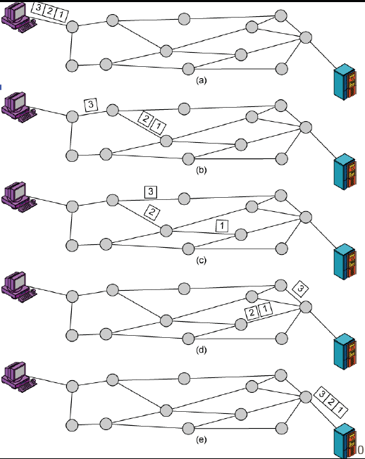
Datagram
Each packet treated independently
Packets can take any practical route
Packets may arrive out of order
Packets may go missing
Up to receiver to re-order packets and recover from missing packets

Slide 66
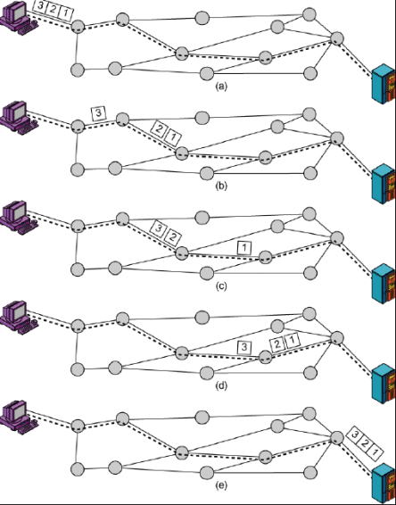
Virtual Circuit
Preplanned route established before any packets sent
Call request and call accept packets establish connection (handshake)
Each packet contains a virtual circuit identifier instead of destination address
No routing decisions required for each packet
Clear request to drop circuit
Not a dedicated path

Slide 67
Bringing it all together

Slide 68
Synchronous and Asynchronous Transmission - Hierarchy
Hierarchy of synchronization tasks:
Bit level: recognizing the start and end of each bit
Byte (character) level
Block or message level: recognize the start and end of each unit of data (in networks this is a frame)
A fundamental requirement of digital data communications is that the receiver knows the starting time and the duration of each bit

Slide 69
Asynchronous Transmission
each character (or byte) is treated independently for clock (bit) and character (byte) synchronization purposes
the receiver resynchronizes at the start of each character received.

Slide 70
Synchronous Transmission
A continuous stream of data signals is accompanied by timing signals (generated by an electronic clock)
Ensures that the transmitter and the receiver are in step (synchronized) with one another
The data is sent in blocks (called frames or packets) spaced by fixed time intervals

Slide 71
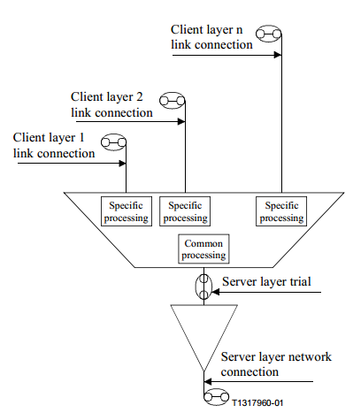
Multiplexing
Several link connections of client layer networks supported by one server layer trail at the same time
Source: ITU-T Recommendation G.805

Slide 72
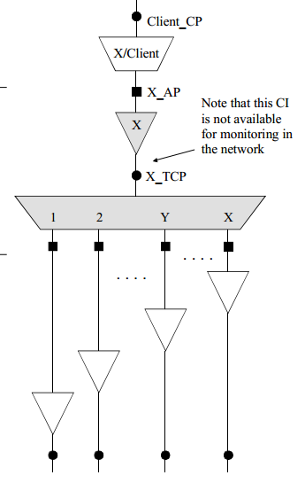
Inverse multiplexing
Client layer link connection is supported by several server layer trails in parallel
Source: ITU-T Recommendation G.805

Slide 73
Monitoring techniques
Connection may be indirectly monitored by using the data inherently available from the server layer
Non-intrusive monitoring
Intrusive monitoring
Sublayer monitoring: some portion of the original capacity is overwritten by the test signal

Slide 74
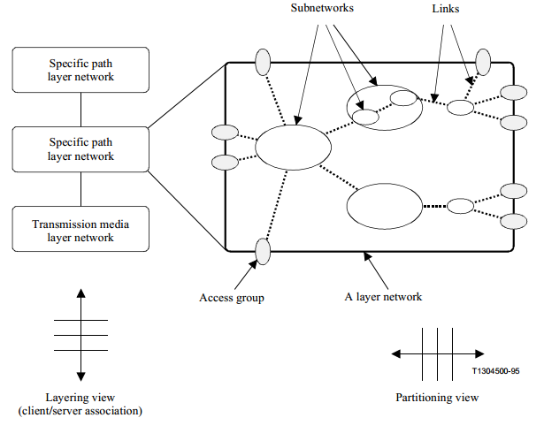
Partitioning and layering
A transport network can be decomposed into a number of independent transport layer networks with a client/server association between adjacent layer networks
Each layer network can be separately partitioned in a way which reflects the internal structure of that layer network or the way that it will be managed
Source: ITU-T Recommendation G.805

Slide 75
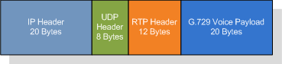
Layering
When standard networks were first proposed it was realized that the subject was so complex that it had to be broken down into more readily digestible parts
Layering is employed despite the fact that it significantly reduces the efficiency of communications networks
For example, in a VoIP application one may go to great lengths to compress 10 milliseconds of telephony quality speech from 80 Bytes down to 10 Bytes, but to that payload:
one then adds an RTP header of at least 12 bytes
a UDP header of 8 bytes
an IPv4 header of 20 bytes
an Ethernet header and trailer of at least 18 bytes
for a grand total of at least 48 bytes of overhead

Slide 76
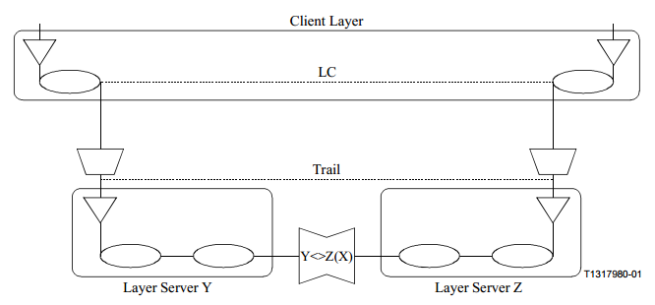
Layer network interworking
The objective of layer network interworking is to provide an end-to-end trail between different types of layer networks
The interworking link connection is special in the sense that it is asymmetric, delimited by different types of ports
Source: ITU-T Recommendation G.805

Slide 77
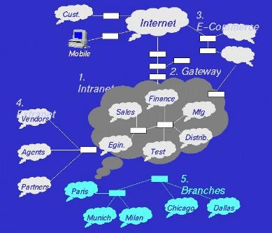
Partitioning
The partitioning defines:
administrative boundaries between network operators jointly providing connections within a single layer network
domain boundaries within a layer network of a single operator to allow the apportioning of performance objectives to the architectural components

Slide 78
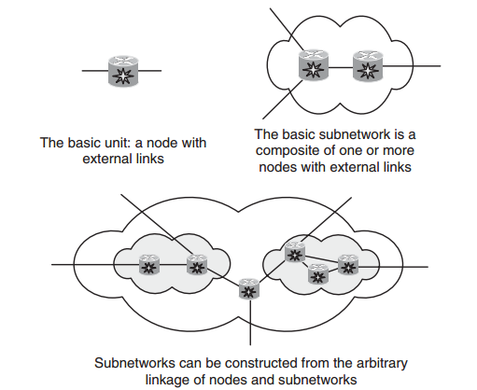
Subnetworks
A subnetwork is defined as an arbitrary collection of (usually connected) nodes or subnetworks
The most basic subnetwork consists of a single node
Subnetworks can be nested
Source: GMPLS: Architecture and Applications by Adrian Farrel and Igor Bryskin

Slide 79
Questions?

